Slide 1
Fundamental problems in Distributed Computing
Efficient distribution of work
combating serialization
Consensus
combating failure

Slide 2
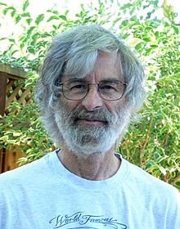
Leslie Lamport

Slide 3
Consensus
In almost any cluster of machines
Spark, Kafka, Cassandra, etc
We need:
A consistent configuration
(often) A controller
The controller may fail
Therefore we need to be able to detect that and elect a new leader/controller

Slide 4
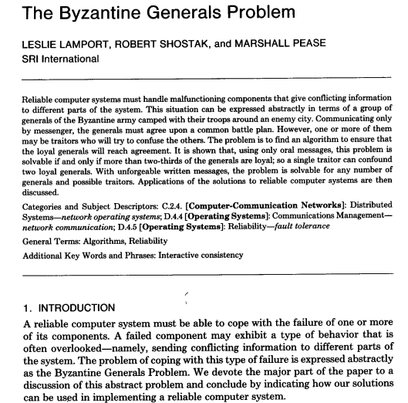

Slide 5
Byzantine failures
A Byzantine fault is any fault presenting different symptoms to different observers.
Imagine a set of generals trying to formulate a plan
Some of the generals are traitors
They may lie to other generals
They may lie selectively

Slide 6
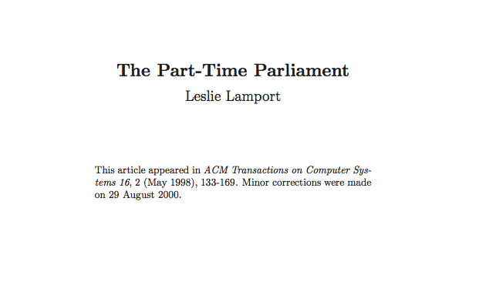

Slide 7
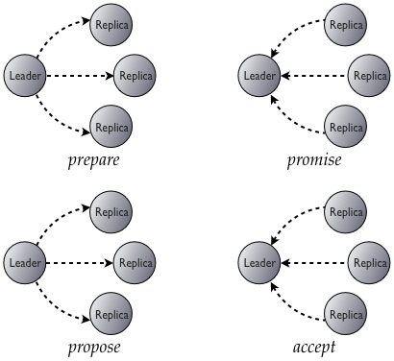

Slide 8
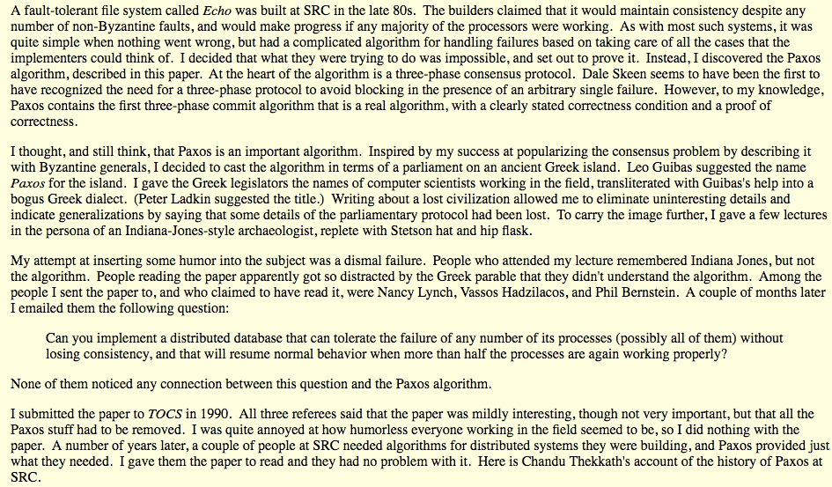

Slide 9
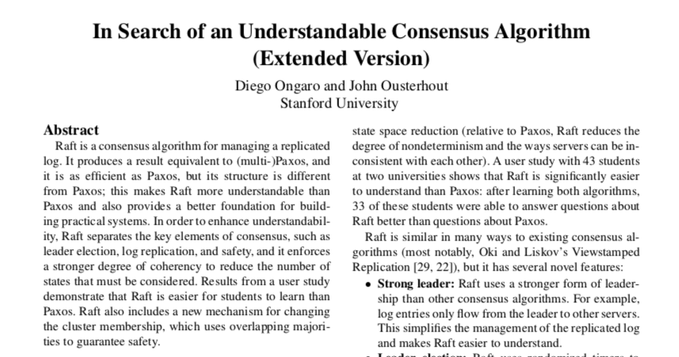
Raft

Slide 10
Raft consists of two main parts
Leadership elections
Creating a consistent log once a leader is in place

Slide 11
Raft Key concepts
Leader
The leader ingests new log entries, distributes to peers and decides when they are commited.
Quorum
(n mod 2)+1 members, where n is the size of the peer set
Peer Set
The set of nodes participating
Finite State Machine
A Finite State Machine is well defined set of states and transitions. Ensures that each peer behaves identically
Committed Entry
An entry is committed if it is stored persistently on a quorum of nodes. Then it can be applied.
Log
The log is consistent iff all participants agree on the entries and the order

Slide 12
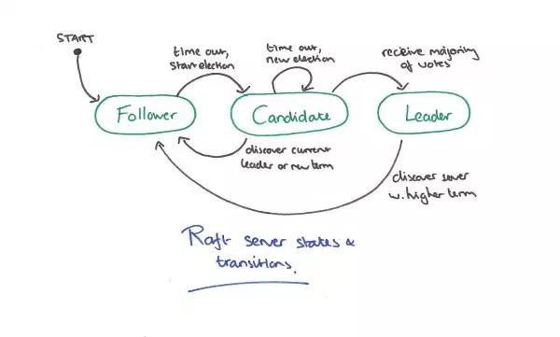
Raft Leadership Election
https://blog.acolyer.org/2015/03/12/in-search-of-an-understandable-consensus-algorithm/

Slide 13
Once a leader is in place
Client requests the leader writes a log entry
The leader writes it to durable storage
Replicates to a quorum of followers
Once the log entry is committed, it can be applied
Execute the FSM with the new data

Slide 14
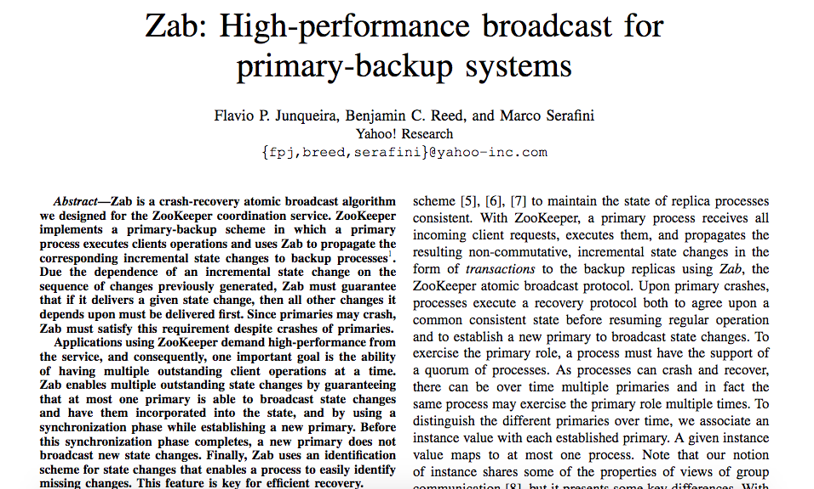

Slide 15
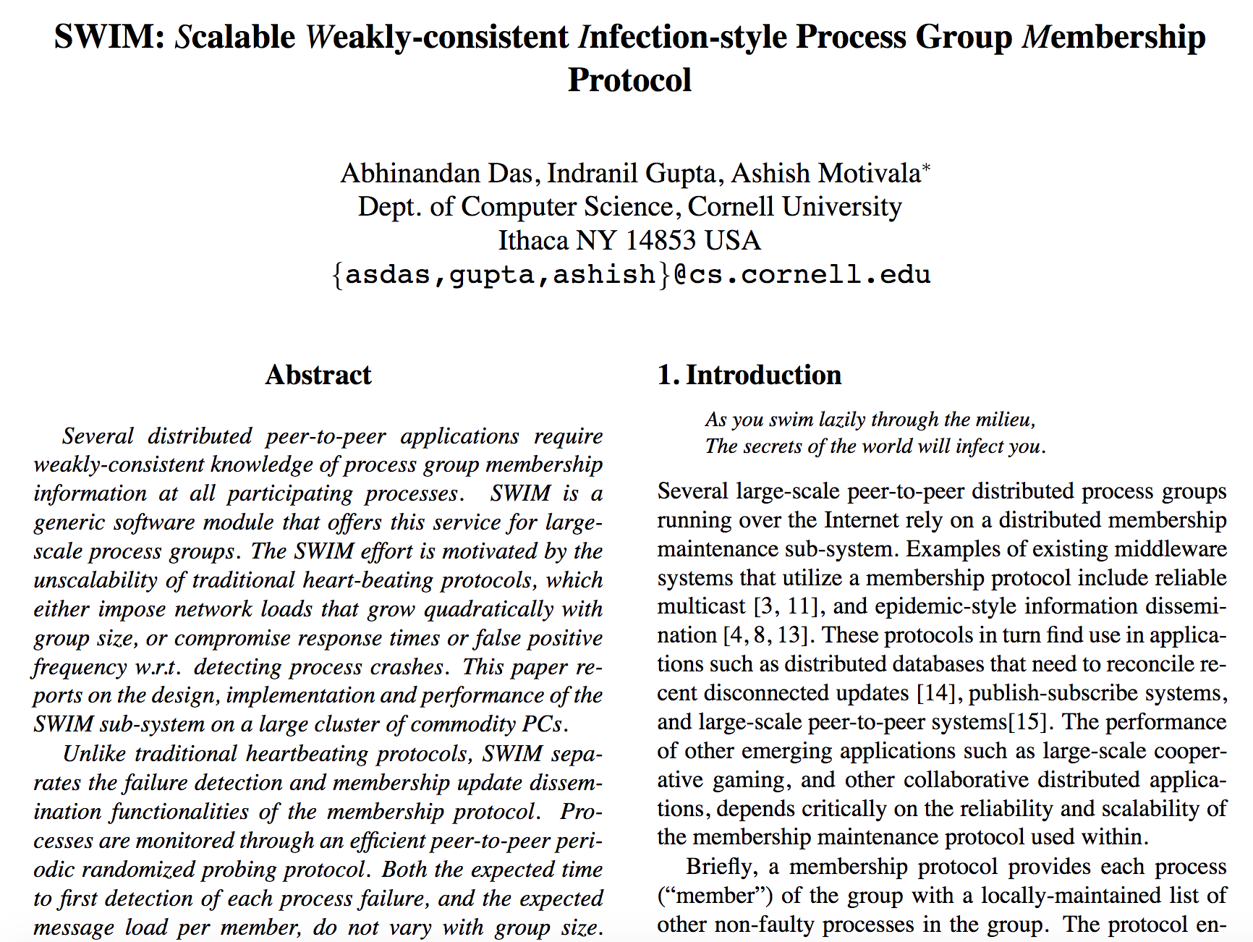

Slide 16
Conflict-free Replicated Data Types
Also known as Commutative Replicated Data Types

Slide 17
Different systems and their consensus algorithms
Zookeeper – ZAB
Cassandra – Paxos
Consul – Raft
etcd – Raft
Weave Mesh – CRDT
Serf – SWIM

